Slide 1
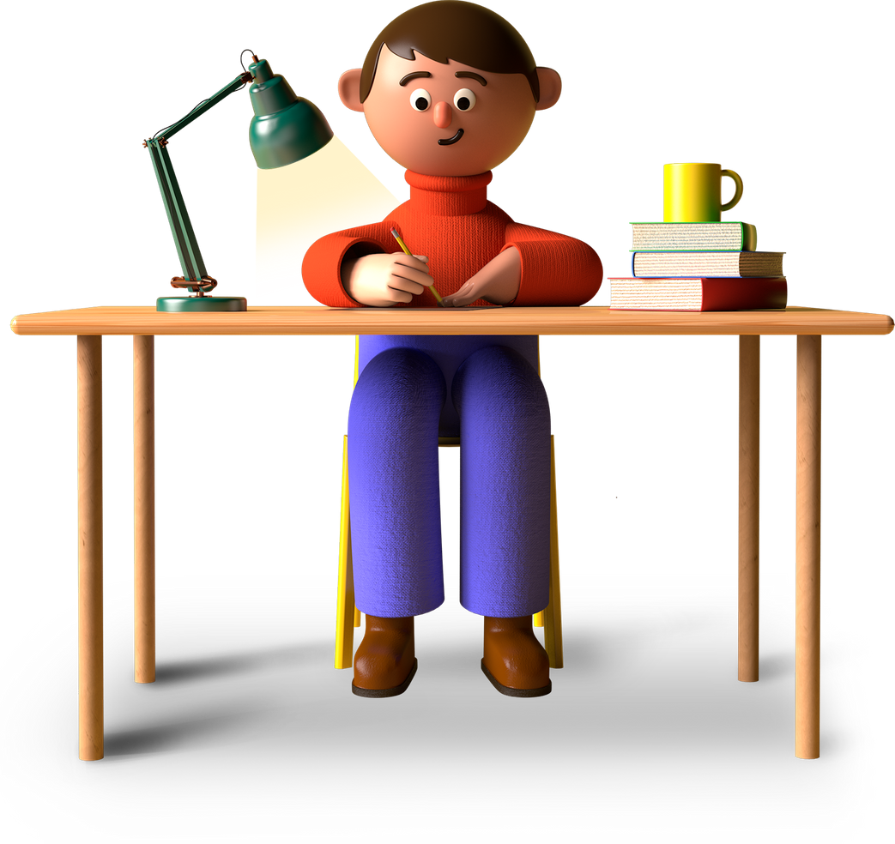
Fun Hacks | Marceline Anderson
Learn Better
Millennial Hacks Series
01
Presentation by Marceline Anderson

Slide 2
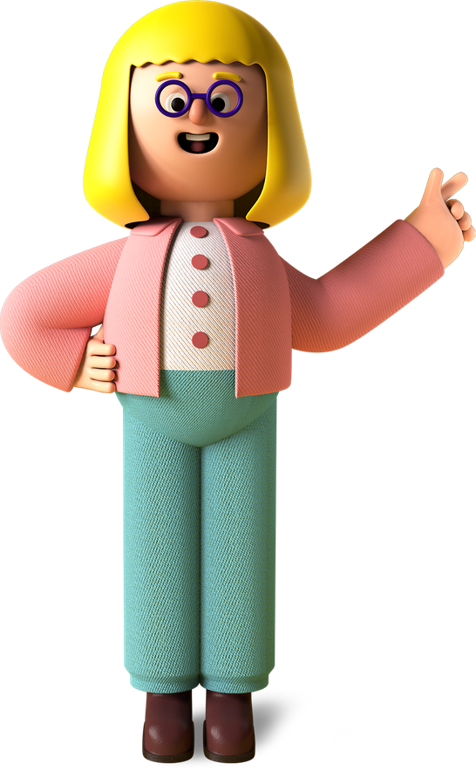
Fun Hacks | Marceline Anderson
What's essential for all millennials regardless of their career?
Mastering the art of learning (and having fun with it!)
04

Slide 3
